Slide 1
Curriculum Proposal Process
New Course and Revise Course Proposals
Proposal questions should be directed to CurriculumForms@ilstu.edu
Refer to the Curriculum website for additional resources:
https://curriculum.illinoisstate.edu/procedures/

Slide 2
First Steps
For New Course Proposals or Revise Course Proposals that include a request to change the course number
Before starting the course proposal in the Curriculum Forms System
Refer to the Curriculum website for general information about course levels: https://curriculum.illinoisstate.edu/procedures/definitions/#course-levels
Visit the Course Finder website https://coursefinder.illinoisstate.edu/directory/ Review the course directory for the subject area that you want to create a new course under to identify a course number that is not currently active
Email curriculumforms@ilstu.edu to inquire about the course number(s) that you would like to use. Someone will get back to you to confirm whether the course number is available. After a course number is inactivated, it may not be reused for 5 years

Slide 3
First Steps
Prepare the course syllabus. Refer to the Curriculum website for the structure/format: https://curriculum.illinoisstate.edu/procedures/syllabus/#university
Login to Curriculum Forms https://registrar.illinoisstate.edu/curriculumforms/
If a box does not appear for you to enter your User Name and Password, disable the "pop-up blocker" feature of your internet browser.
Use your Illinois State email address (e.g. rredbird@ilstu.edu) as the username and your email password to login.
You can also prefix your ULID with "adilstu\" (e.g. adilstu\rredbird) as the username. Some browsers allow the use of your ULID only.
If prompted for a Domain use "adilstu" and only your ULID as the username.

Slide 4
Select New or Revise Course from the top navigation
Select either Create Undergraduate or Graduate Proposal
You should have at least one coauthor for each proposal so that more than one person in a department/school has the ability to access and edit the proposal
Complete the proposal
Abbreviated Titles are what is printed on transcripts
Course Numbers for decimalized courses must use an “a” instead of an “.”
Upload a syllabus if required by your Department or College Curriculum Committee. A syllabus is required to be uploaded for all new course proposals.

Slide 5
Indicate if the course is associated with a program proposal(s) If the program proposal is to be associated with a course proposal (a course added to a program as required or as an elective), the program proposal must be started before the course proposal(s) in order for the system to associate them.
Contact hours are the number of hours of scheduled instruction
2 hours (100 minutes) of lab totals 1 credit hour
1 hour (50 minutes) lecture totals 1 credit hour Refer to the Credit Hour Policy for more information https://policy.illinoisstate.edu/academic/4-1-19/

Slide 6
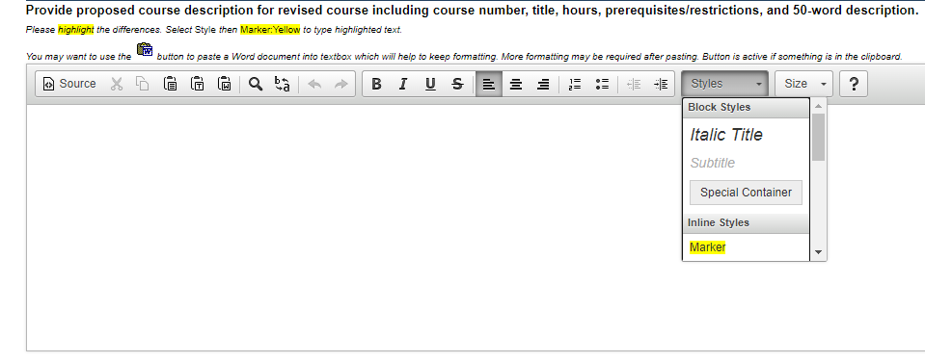
For Revise Course Proposals
Copy and paste directly from the Course Finder website https://coursefinder.illinoisstate.edu/directory/ for the current course description and again for the proposed course description
Use the highlight and/or strikethrough text tools to indicate changes.

Slide 7
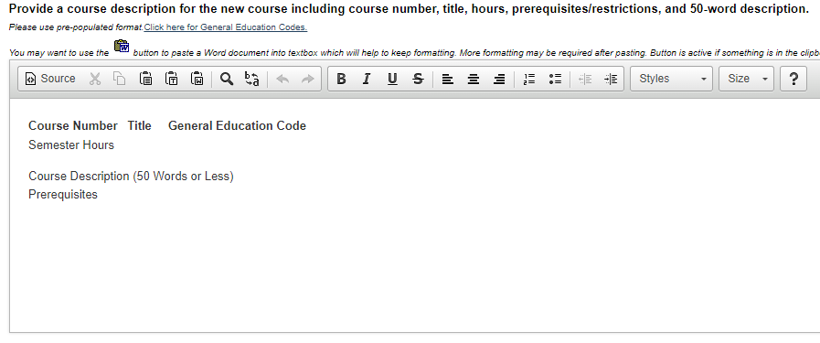
For New Course Proposals
Visit the Course Finder website https://coursefinder.illinoisstate.edu/directory/ to see examples of the course description information required for the proposal
Full title, credit hours, course description including any prerequisites
If appropriate, include reference to:
ISU General Education Program category https://coursefinder.illinoisstate.edu
AMALI or IDEAS
B.S.-SMT
Do not indicate Illinois Articulation Initiative (IAI) codes at this time, the approval for IAI courses is outside of the ISU curriculum approval process (this will be addressed later in this presentation)

Slide 8
Cross-listed courses are ONE course developed by two or more departments. The course may be offered by any of these departments.
Since it is ONE course, if a student takes the course offered by one department and then registers for it a second time but from another department, the course repeat rules will apply. The course description must include the statement in red: Exploration and analysis of current health and lifestyle issues. Emphasis on how individuals, communities and society make health decisions. Equivalent course, offered as FCS, HSC, KNR 208; repeat policy will apply. https://coursefinder.illinoisstate.edu/fcs/208/
For the prompt: “Does this course replace any existing courses” – Indicate “Yes” if the course is changing a temporary course (ending in “89” – 189, 289, etc.) a permanent course, or will replace another course. The statement “Formerly ABC 123” must be included in the course description.

Slide 9
The prompt: “count for credit if a previous course has been taken” Indicate “No” If this course substantially duplicates content in another course (BUT is not replacing the course and is not an exact equivalent of the course. The course description must include the statement: “Not for credit if earned credit in ABC 123” This statement will prompt our office to add a block to the course that will block students from enrolling in the course if they have previously earned credit in the course stated.
In this situation, even if an advisor gives a student a permit to enroll in the course (override the registration block) – the student will NOT be able to earn credit in the course.

Slide 10
Indicate “Yes” for the prompt: “May multiple enrollments be allowed? (Formerly known as “May be repeated for credit if content is different”).” if students may repeat the course multiple times for credit.
Note the following:
The course Repeat Policy DOES NOT apply for these courses. A student will not be able to repeat the course for a different grade (even if it is the same instructor and the same “topic area”
The SAME course title will show on the students’ transcripts for every enrollment/completion of the course
You may indicate a maximum number of credit hours or number of enrollments a student may complete. This MUST be indicated in the course description. If you do not indicate a maximum, we will build the course will an unlimited number of credit hours/enrollments
If you want to have unique course titles for topic areas, you should create separate individual courses for each topic area. These should NOT be created as “multiple enrollment” courses

Slide 11
Undergraduate Course Proposals
If you select “Yes” for “Is this course being proposed as an ISU General Education course” or for Revise Course Proposals - “This course is not currently offered as a General Education course and should be” the course proposal will route to the Council for General Education for approval
Information on the learning outcomes for the General Education Program course categories is available on the General Education Program website: https://gened.illinoisstate.edu/faculty-info/
Attach documentation to the online proposal indicating how the course addresses the General Education goals specific to the category designation you are requesting.

Slide 12
Undergraduate Course Proposals
The above note refers to the Illinois Articulation Agreement (IAI), which is a state-wide transferrable general education package that transfer student may have completed at the time they transfer or have partially completed at the time they transfer to ISU and then they may complete the requirements at ISU. Learn more about the program: https://itransfer.org/aboutiai/
Courses may be approved for the ISU General Education Program and/or the IAI program. Contact the Director Malinda Aiello at: mmaiell@ilstu.edu

Slide 13
Undergraduate Course Proposals
Students who are graduating with a Bachelor of Science degree must complete an additional Science, Mathematics, or Technology course. To have a course approved as a B.S.-SMT course, indicate the appropriate response to the prompt on the proposal form Learn about the criteria for these courses here: https://illinoisstate.edu/catalog/undergraduate/bs-smt-grad-req/
Cultures and traditions of Asia, the Middle East, Africa, Latin America, or Indigenous (AMALI) Peoples of the World is a graduation requirement for all students. https://illinoisstate.edu/catalog/undergraduate/amali/ Indicate “Yes” at the prompt if you wish to seek AMALI approval for the course.
IDEAS: Inclusion, Diversity, Equity, and Access in U.S. Society is a graduation requirement for all students. https://illinoisstate.edu/catalog/undergraduate/ideas/ Indicate “Yes” at the prompt if you wish to seek IDEAS approval for the course.

Slide 14
Proposal Approval Routing
Department/school curriculum committee and chair
College curriculum committee and college dean
If you indicate “Yes” to the prompt “Does this course count towards teacher education” it must be reviewed and approved by the Council for Teacher Education
If you indicated “Yes” if the course is or to have the course to be reviewed for a General Education Program, AMALI, and/or IDEAS designation, it will be reviewed by the Council for General Education, AMALI and/or IDEAS committee
After the College Curriculum Committee and college dean (and if required CTE, CGE, AMALI, and/or IDEAS) have approved the course proposal, it will be routed to the University Curriculum Committee Secretary for technical review, and campus circulation
Undergraduate course proposals are approved by the University Curriculum Committee Executive Secretary (Provost’s designee – Associate Vice President for Undergraduate Education)
Graduate courses are approved by the Director of the Graduate School
Individual courses are not reviewed by the UCC or the GCC

Slide 15
New courses may be offered once they are approved and are built in Campus Solutions
Revised courses changes do not take effect immediately, they are approved by catalog year. ISU’s catalog year begins in May on the first day of Summer Session
Refer to the Curriculum website for proposal deadlines: https://curriculum.illinoisstate.edu/forms/deadlines/

